Slide 1


Final Year Project Work Pre-Defense
On
Water Quality Classification
Using Random Forest Algorithm
Presented By
Nischal Wagle(23878/076)
Sneha Tuladhar(23891/076)
Sital Gurung(23892/076)
Supervised By
Er. Dhiraj Kumar Jha

Slide 2
Presentation Outline
Introduction
Objectives
System Analysis
System Design
Algorithm Details
Testing
Problem faced
Demonstration

Slide 3
Introduction
Water quality is a vital aspect of environmental health, directly impacting ecosystems, human health, and overall well-being.
Ensuring access to clean and safe water is a global priority for sustaining life and preventing waterborne diseases.
According to a recent survey of World Health Organization (WHO), more than 2.2 billion people face problems due to unsafe drinking water and 21% of the diseases are related to impure water.

Slide 4
Introduction
﻿﻿Traditional methods of water quality monitoring may be time-consuming, expensive, and limited in spatial coverage.
Proposed system takes various parameters of water as the inputs and predicts whether the water sample of the provided parameters are contaminated or not.
Predictive modeling involves utilizing historical data and advanced algorithms to forecast future water quality conditions.

Slide 5
Objectives
To monitor water quality using random forest algorithm.
The application targets users who need to assess water quality and aims to provide an alternative for managing and monitoring water quality.
To develop a system that can classify water quality into different categories (excellent,good,fair,marginal,poor) using the random forest algorithm.
Classifies whether it is safe to drink or not as it is unsafe for drinking without proper treatment but may be suitable for irrigation after rigorous treatment process.

Slide 6
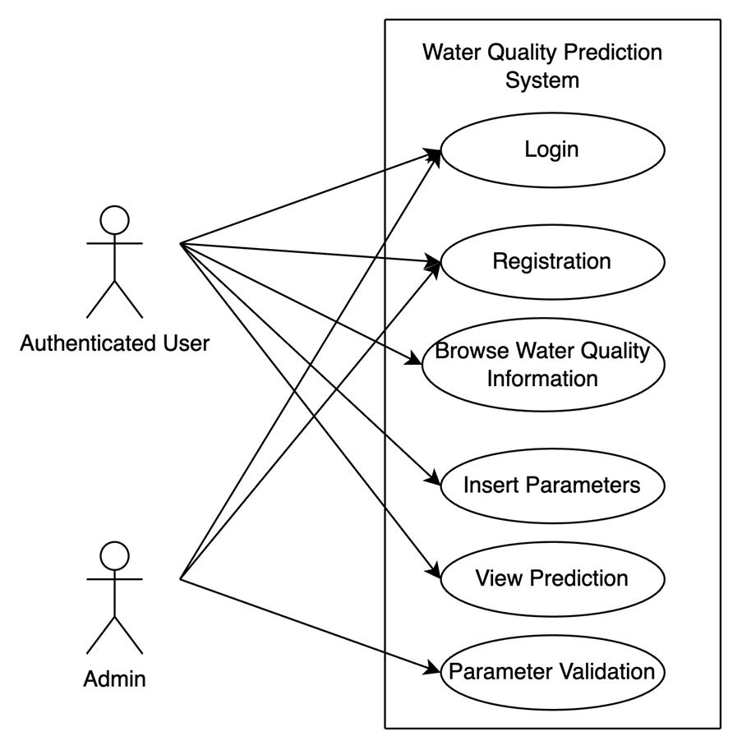
System Analysis: Functional Requirements
Requirement Analysis
Feasibility Analysis
Modeling

Slide 7
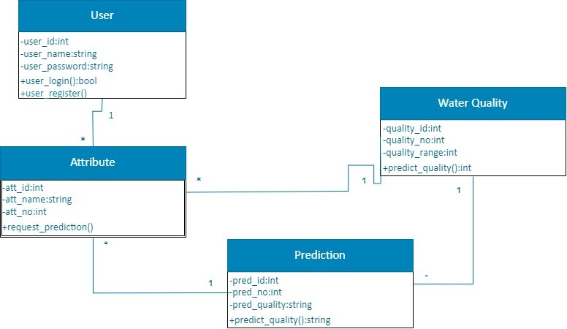
fig:Class Diagram of water quality classification

Slide 8
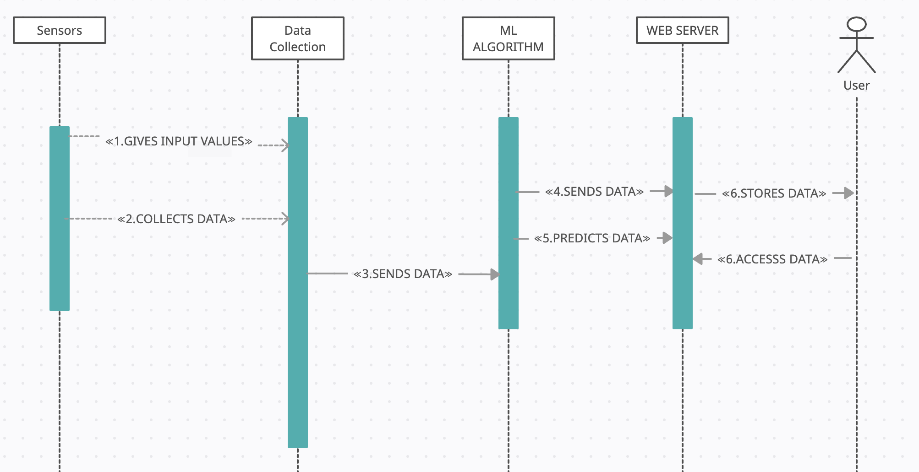
Design

Slide 9
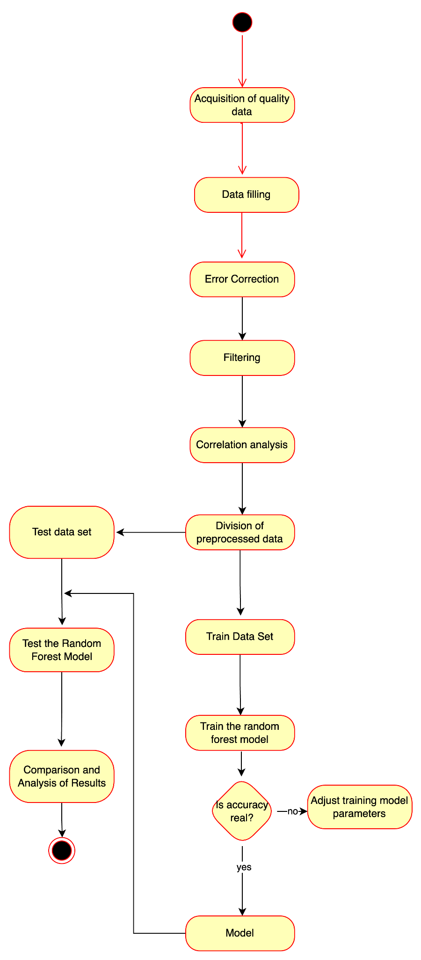
fig:Activity Diagram of Water Quality Classification

Slide 10
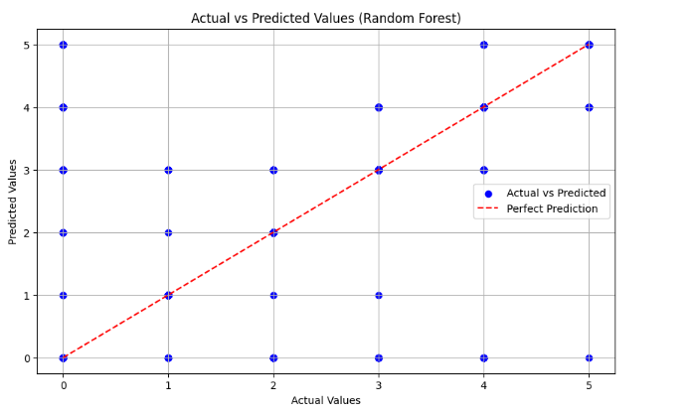
Decision Tree Implementation Result

Slide 11
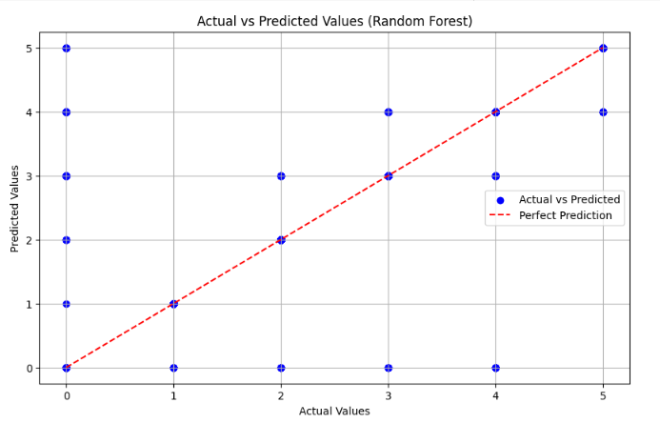
Random Forest Implementation Result

Slide 12
Comparison
Algorithm | R-Squared | MAE | MSE | Execution Time
Random Forest | 0.48 | 0.18 | 0.58 | 8.44 seconds
Decision Tree | 0.42 | 0.21 | 0.65 | 0.74 seconds

Slide 13
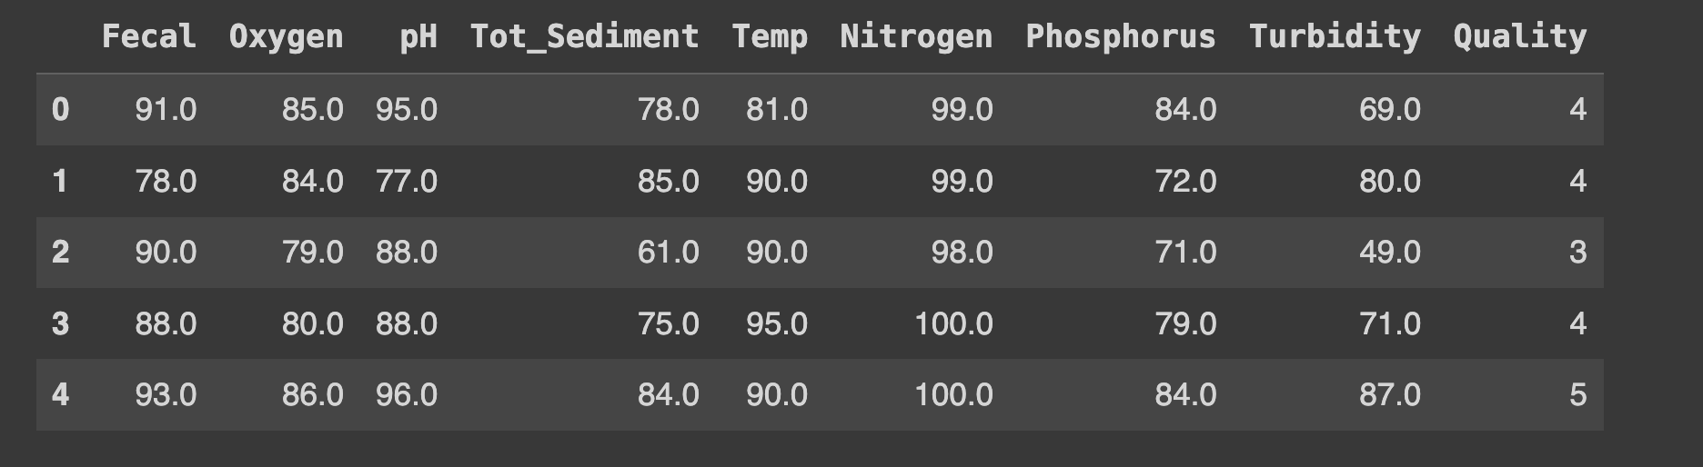
System Analysis: Dataset Description
There are 15000 instances of the data with 9 columns.

Slide 14
System Implementation: Tools used
Development Tools
HTML
CSS
Python
Flask
MySQL, phpMyAdmin
Google Collab
Git and GitHub
2. Design and Management Tools
MS Project
MS Word
Draw.io
MS Visio

Slide 15
Algorithm Details
In this project, we will build two algorithms.
Decision tree algorithm
Random Forest Algorithm

Slide 16
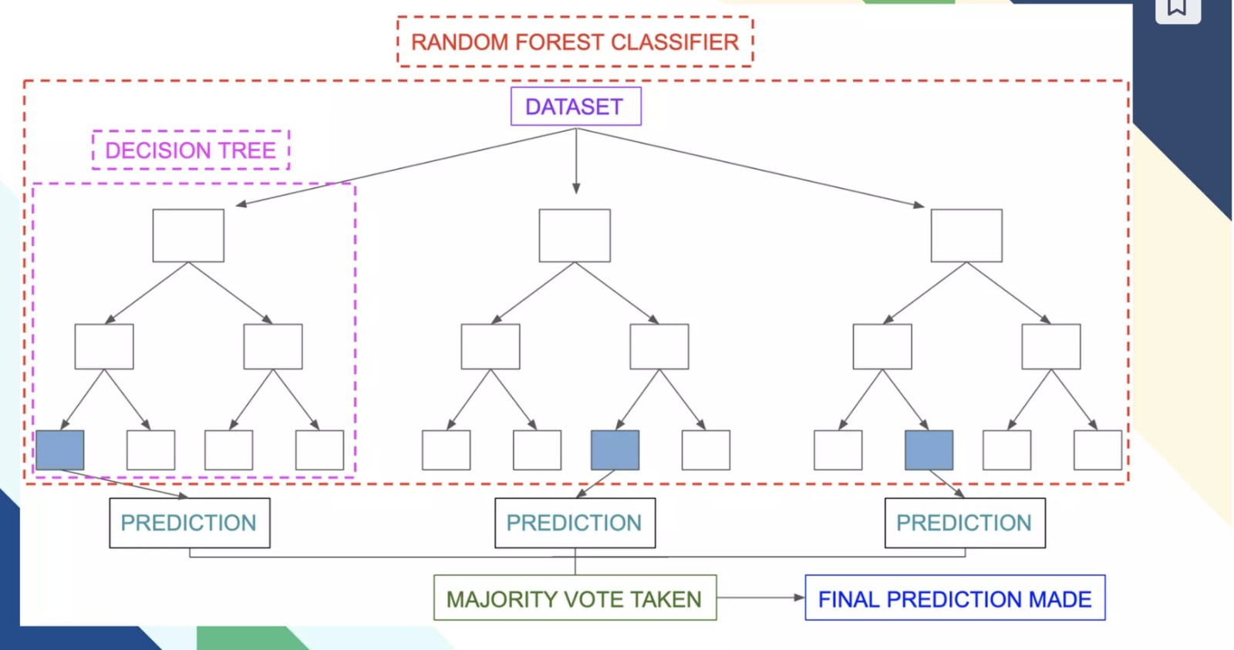

Slide 17
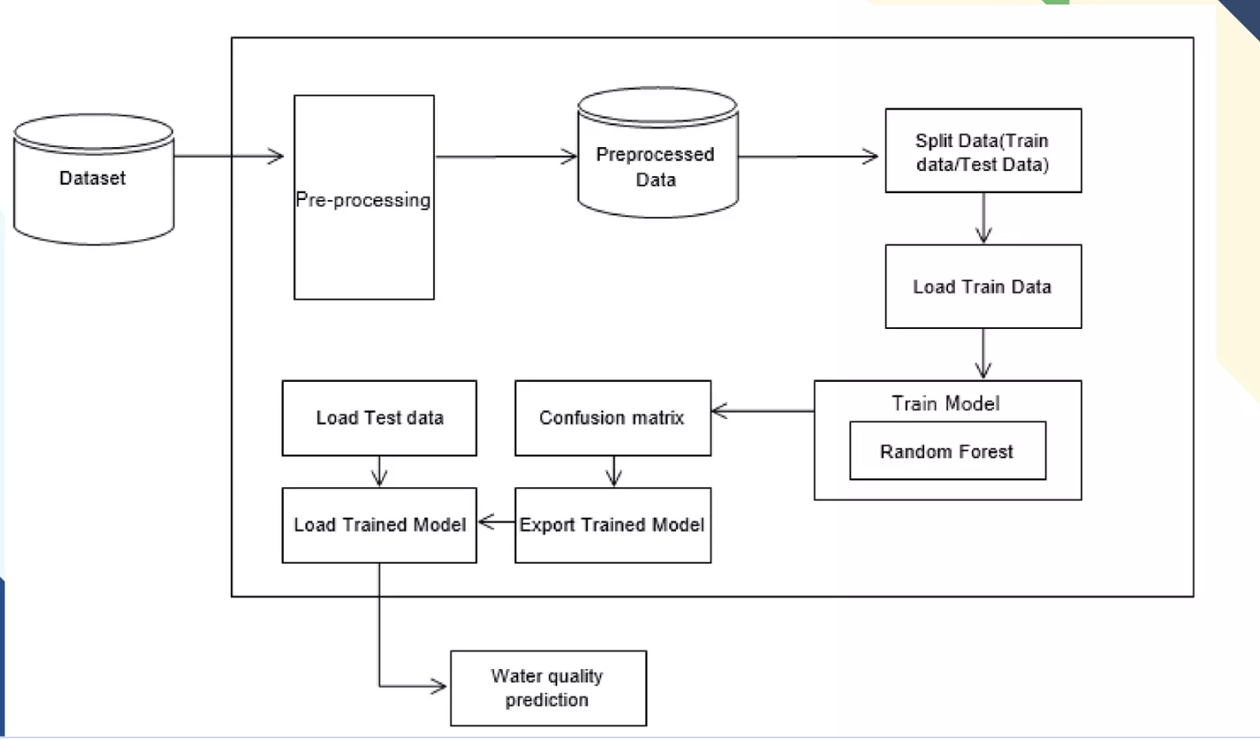
Model Implementation

Slide 18
Testing : Unit Testing
Test Case ID | Test Case | Test Data | Expected outcome | Actual Outcome | Result
TC-1 | User Login Success | Email:sneha@gmail.com Password:***** | User Login to the system Successfully | User Login to the system successfully | Pass
TC-2 | User Login Failure | Email:test@gmail.com Password:**** | User can’t login to the system Successfully | User can’t login to the system Successfully | Fail
TC-3 | User Login Success | Email:sital@gmail.com Password:**** | User can’t login to the system Successfully | User login to the system Successfully | Pass

Slide 19
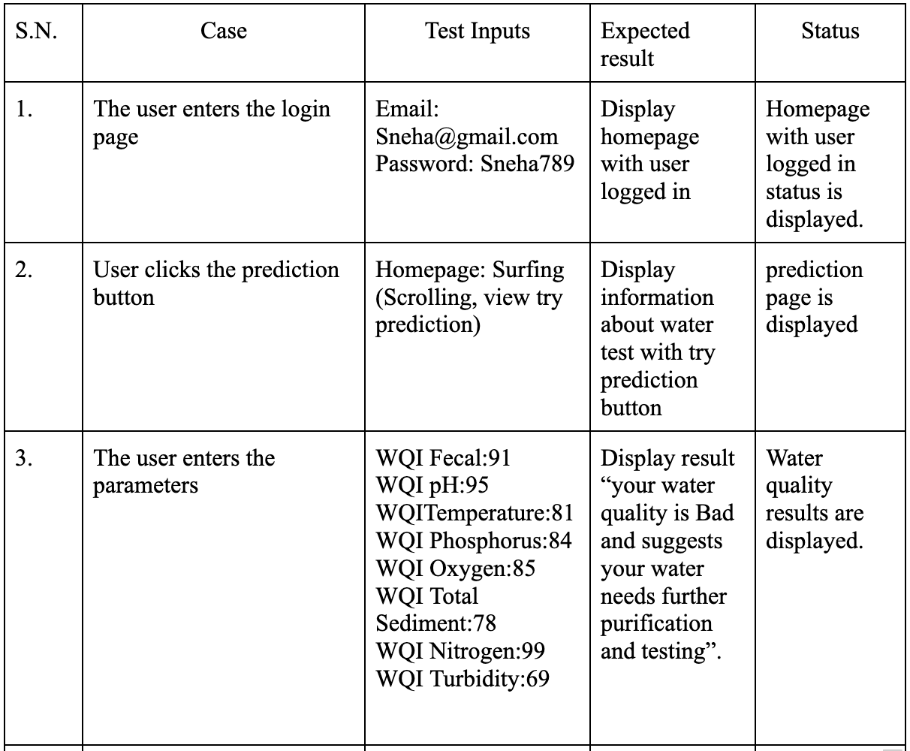
System Testing

Slide 20
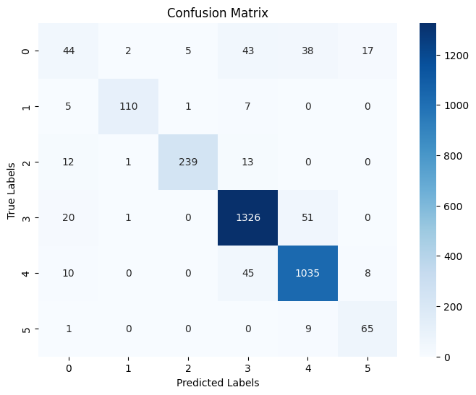
Testing : Model Testing
Fig:Confusion matrix
Performance Testing Using Confusion Matrix The confusion matrix is a valuable tool for evaluating the performance of machine learning models.
It provides a detailed breakdown made by the model, including the number of true positives, true negatives, false positives, and false negatives.

Slide 21
Problem Faced
Integrate recommendation systems into water quality prediction models.
Implement advanced filtering options for personalized recommendations.
Utilize advanced Natural Language Processing (NLP) techniques for enhanced search accuracy.
Expand class labels for finer classification of water quality parameters.

Slide 22
Conclusion and Future Recommendation
Add historical data
Make use of recommendation systems
Development of mobile application

Slide 23
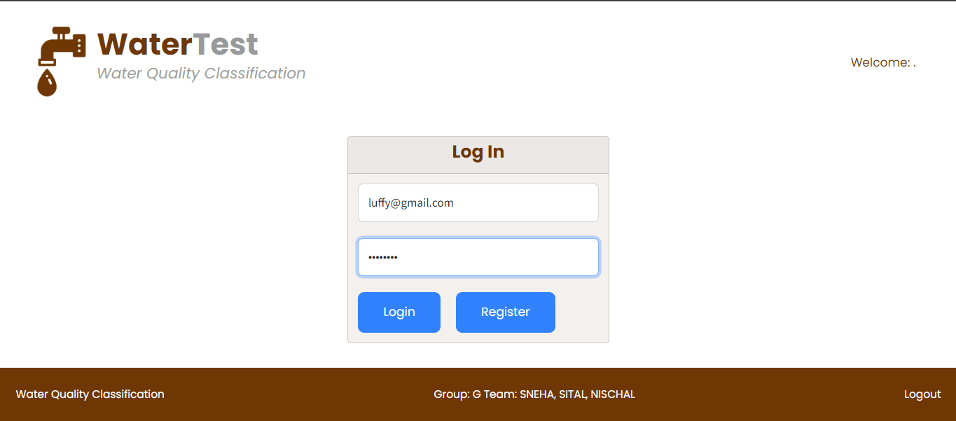
Demonstration

Slide 24
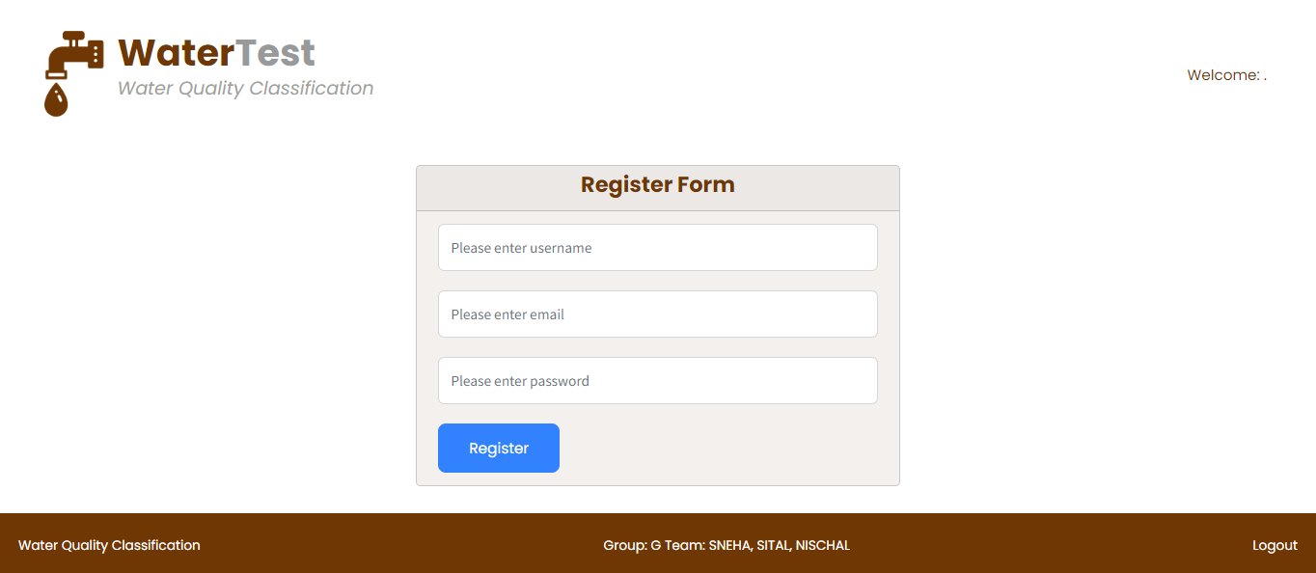

Slide 25
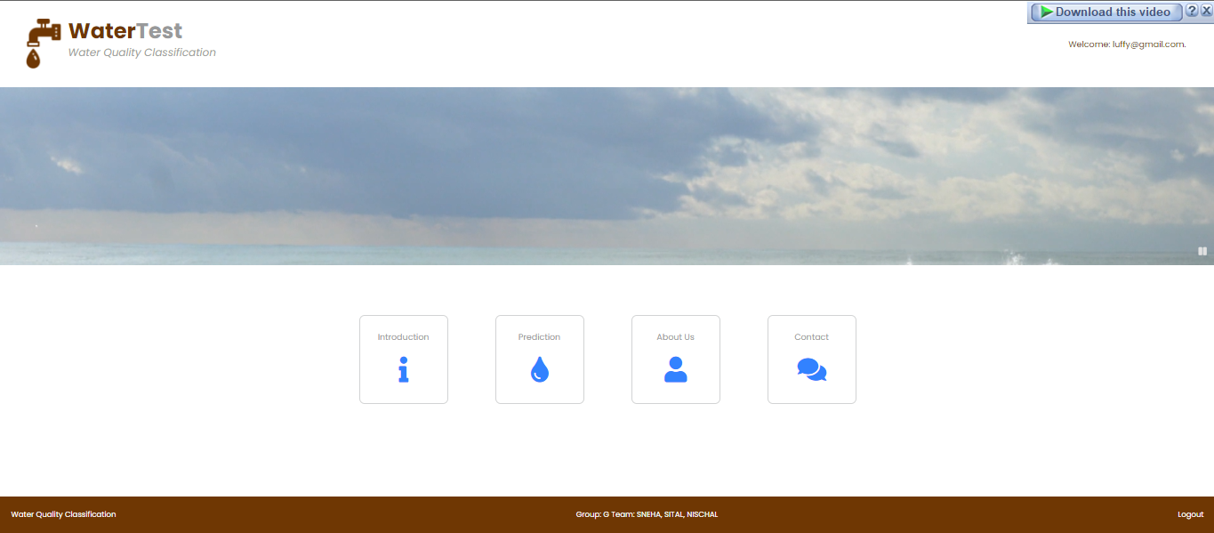

Slide 26
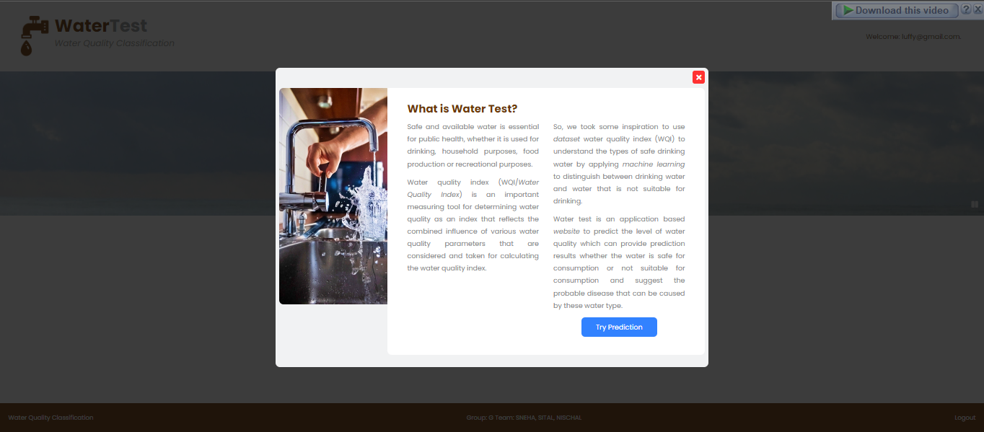

Slide 27
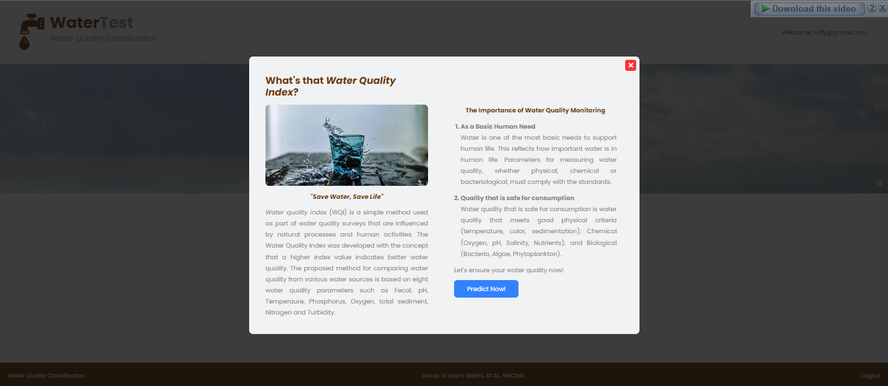

Slide 28
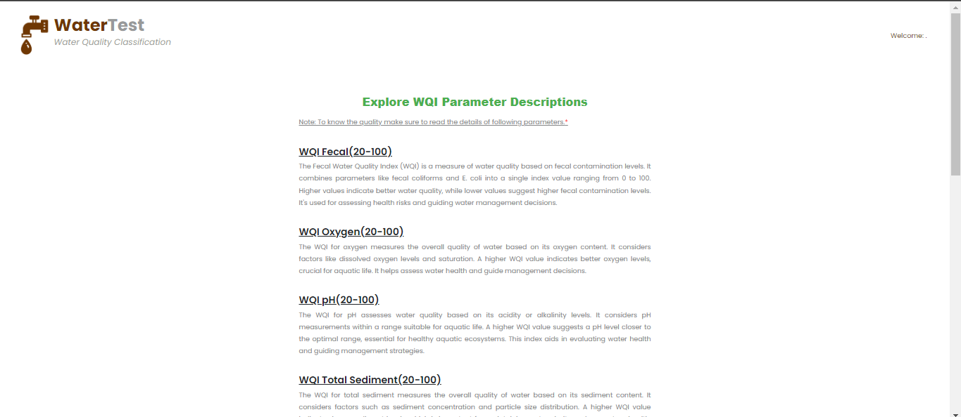

Slide 29
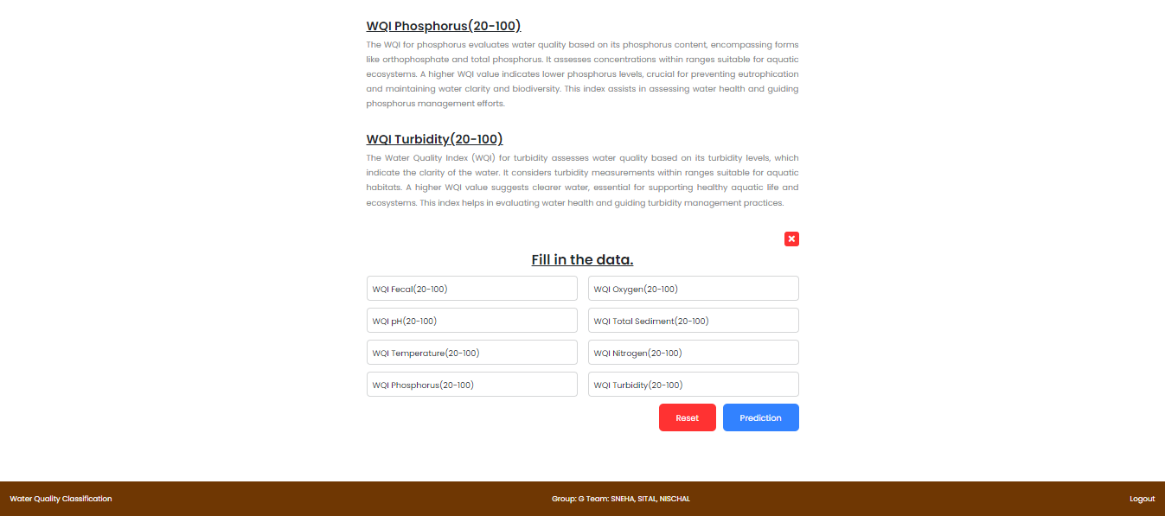

Slide 30
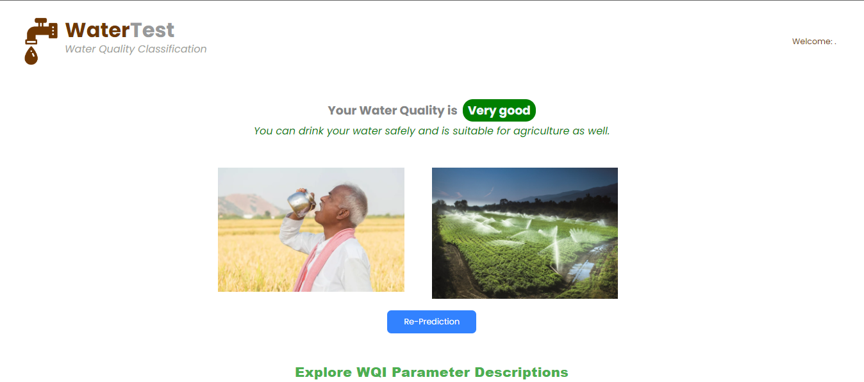

Slide 31
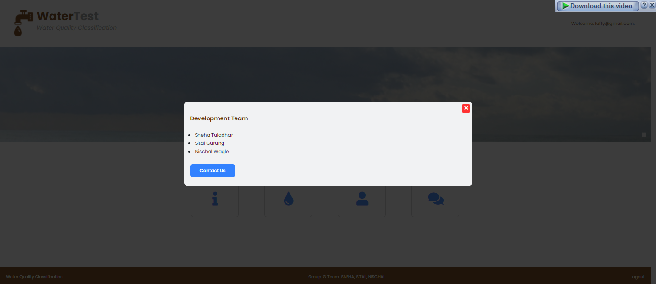

Slide 32
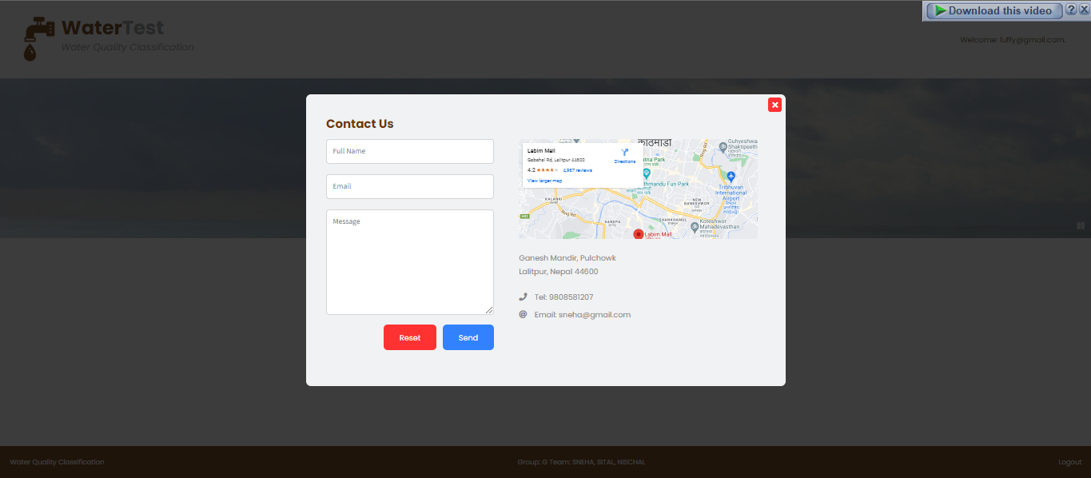

Slide 33
Thank you

